Slide 1

JAVA PROGRAMMING
UNIT - V

Slide 2
Syllabus
Exception
Fundamentals,
Handling: Exception-Handling Exception Types, Uncaught
Exceptions, using Clauses, throw, Exceptions.
try and catch, throws, finally,
Multiple catch Java’s Built-in

Slide 3
Exception Handling - Introduction
An exception is an abnormal condition that arises in a code sequence at run time.
In other words, an exception is a run-time error.
It is an event triggered during the execution of the program which interrupts the execution and stops the execution abruptly and handling this event is called exception handling.

Slide 4
Exception Handling - Fundamentals
A Java exception is an object that describes an exceptional (that is, error) condition that has occurred in a piece of code.
When an exceptional condition arises, an object representing that exception is created and thrown in the method that caused the error.
That method may choose to handle the exception itself, or pass it on.
Either way, at some point, the exception is caught and processed.

Slide 5
…
Exceptions can be generated by the Java run-time system, or they can be manually generated by your code.
Exceptions thrown by Java relate to fundamental errors that violate the rules of the Java language or the constraints of the Java execution environment.
Manually generated exceptions are typically used to report some error condition to the caller of a method.

Slide 6
…
In Java exception handled by Five keywords: try, catch, throw, throws, and finally.
Program statements that you want to monitor for exceptions are contained within a try block. If an exception occurs within the try block, it is thrown.
Your code can catch this exception (using catch) and handle it in some rational manner.
System-generated exceptions are automatically thrown by the Java run-time system.
To manually throw an exception, use the keyword throw. Any exception that is thrown out of a method must be specified as such by a throws clause.
Any code that absolutely must be executed after a try block completes is put in a finally block.

Slide 7
General form of an exception-handling block:
try {
// block of code to monitor for errors
}
catch (ExceptionType1 exOb) {
// exception handler for ExceptionType1
}
catch (ExceptionType2 exOb) {
// exception handler for ExceptionType2
}
// ...
finally {
// block of code to be executed after try block ends
}
Here, ExceptionType is the type of exception that has occurred.

Slide 8
…
Note:
try must be followed by catch
try & catch must be perfect pairs.
A try can be followed by multiple catches.

Slide 9
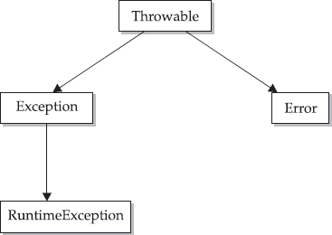
Exception Types

Slide 10
…
All exception types are subclasses of the built- in class Throwable.
Throwable is at the top of the exception class hierarchy.
Exception is a subclass of Throwable. Exception class is used for catching exceptional conditions arise in the user programs. This is also the class that you will subclass to create your own custom exception types.

Slide 11
…
There is an important subclass of Exception, called RuntimeException.
Exception of this type are automatically defined for the programs that you write and include things such as division by zero and invalid array indexing

Slide 12
Error is another subclass of Throwable.
Error defines the exceptions that are not expected to be caught under normal circumstances by your program.
These are not exceptions at all, but problems that arise beyond the control of the user or the programmer.
Errors are typically ignored in your code because you can rarely do anything about an error.
For example, if a stack overflow occurs, an error will arise.

Slide 13
Three Categories of Exceptions
1. Checked exceptions: A checked exception is an exception that occurs at the compile time, these are also called as compile time exceptions. These exceptions cannot simply be ignored at the time of compilation, the programmer should take care of (handle) these exceptions.
For example, if you use FileReader class in your program to read data from a file, if the file specified in its constructor doesn't exist, then a FileNotFoundException occurs, and the compiler prompts the programmer to handle the exception.

Slide 14
Three Categories of Exceptions
2. Un checked exceptions: An unchecked exception is an exception that occurs at the time of execution. These are also called as Runtime Exceptions. These include programming bugs, such as logic errors or improper use of an API. Runtime exceptions are ignored at the time of compilation.
For example, if you have declared an array of size 5 in your program, and trying to call the 6th element of the array then an
ArrayIndexOutOfBoundsExceptionexception occurs.

Slide 15
Three Categories of Exceptions
3. Errors: These are not exceptions at all, but problems that arise beyond the control of the user or the programmer. Errors are typically ignored in your code because you can rarely do anything about an error.
For example, if a stack overflow occurs, an error will arise. They are also ignored at the time of compilation.

Slide 16
Uncaught Exceptions
class Exc0 {
public static void main(String args[]) { int d = 0;
int a = 42 / d;
}
}
When the Java run-time system detects the attempt to divide by zero, it constructs a new exception object and then throws this exception.
This causes the execution of Exc0 to stop, because once an exception has been thrown, it must be caught by an exception handler and dealt with immediately.

Slide 17
…
Exception generated by
the above program:
by zero at
java.lang.ArithmeticException: / Exc0.main(Exc0.java:4)
Notice that here Exc0 is a class name; the method name main(); and the filename is Exc0.java; and the line number, 4, are all included in the simple stack trace.
Also, notice that the type of exception thrown is a subclass of Exception called ArithmeticException, which more specifically describes what type of error happened.

Slide 18
Using try and catch
Benefits of using user defined Exception handler:
It allows you to fix the error.
It prevents the program from automatically terminating.
To guard against and handle a run-time error, simply enclose the code that you want to monitor inside a try block. Immediately following the try block, include a catch clause that specifies the exception type that you wish to catch. To illustrate how easily this can be done, the following program includes a try block and a catch clause that processes the ArithmeticException generated by the division-by-zero error

Slide 19
…
class Exc2 {
public static void main(String args[]) { int d, a;
try {
d = 0;
a = 42 / d;
System.out.println("This will not be printed.");
}
catch (ArithmeticException e) {
System.out.println("Division by zero.");
}
System.out.println("After catch statement.");
}
}
Output: Division by zero. After catch statement.

Slide 20
…
Notice that the call to println( ) inside the try block is never executed. Once an exception is thrown, program control transfers out of the try block into the catch block.
Put differently, catch is not “called,” so execution never “returns” to the try block from a catch.
Thus, the line “This will not be printed.” is not displayed. Once the catch statement has executed, program control continues with the next line in the program following the entire try/catch mechanism.
A try and its catch statement form a unit. The scope of the catch clause is restricted to those statements specified by the immediately preceding try statement.

Slide 21
ExceptionPin thrreoad "mbainl" ejavam.lang.AriwthmetiictExhcepotion:u/ bytzereo
xception
handling
public class TryCatchExample1 {
public static void main(String[] args) {
int data=50/0; //may throw exception System.out.println("rest of the code");
}
}
Output: Exception in thread "main" java.lang.ArithmeticException: / by
zero
As displayed in the above example, the rest of the code is not executed (in such case, the rest of the code statement is not printed).
There might be 100 lines of code after the exception. If the exception is not handled, all the code below the exception won't be executed.

Slide 22
Solution by exception handling
public class TryCatchExample2 {
public static void main(String[] args) {
try
{
int data=50/0; //may throw exception
}
//handling the exception
catch(ArithmeticException e)
{
System.out.println(e);
}
System.out.println("rest of the code");
}
}
Output:
java.lang.ArithmeticException: / by zero
rest of the code
As displayed in the above example, the rest of the code is executed, i.e., the rest of the code statement is printed.

Slide 23
Example 3
public class TryCatchExample3 {
public static void main(String[] args) {
try
{
int data=50/0; //may throw exception
// if exception occurs, the remaining statement will not exceute System.out.println("rest of the code");
}
// handling the exception
catch(ArithmeticException e)
{
System.out.println(e);
}
}
}
Output: java.lang.ArithmeticException: / by zero
Here, we can see that if an exception occurs in the try block, the rest of the try block code will not execute.

Slide 24
Example 4 - example to print a custom message on exception.
public class TryCatchExample5 {
public static void main(String[] args) {
try
{
int data=50/0; //may throw exception
}
// handling the exception
catch(Exception e)
{
// displaying the custom message System.out.println("Can't divided by zero");
}
}
}
Output: Can't divided by zero

Slide 25
Example to resolve the exception in a catch block.
public class TryCatchExample6 {
public static void main(String[] args) {
int i=50;
int j=0;
int data;
try
{
data=i/j; //may throw exception
}
// handling the exception
catch(Exception e)
{
// resolving the exception in catch block System.out.println(i/(j+2));
}
}
}
Output: 25

Slide 26
Example - example to handle unchecked exception.
public class TryCatchExample9 {
public static void main(String[] args) {
try
{
int arr[]= {1,3,5,7};
System.out.println(arr[10]); //may throw exception
}
// handling the array exception
catch(ArrayIndexOutOfBoundsException e)
{
System.out.println(e);
}
System.out.println("rest of the code");
}
}
Output : java.lang.ArrayIndexOutOfBoundsException: 10 rest of the code

Slide 27
Multiple catch Clauses
In some cases, more than one exception could be raised by a single piece of code.
To handle this type of situation, you can specify two or more catch clauses, each catching a different type of exception.
When an exception is thrown, each catch statement is inspected in order, and the first one whose type matches that of the exception is executed.
After one catch statement executes, the others are bypassed, and execution continues after the try/catch block.
The following example traps two different exception types:

Slide 28
Example
class MultiCatch {
public static void main(String args[]) { try {
int a = args.length; System.out.println("a = " + a); int b = 42 / a;
int c[] = { 1 }; c[42] = 99;
}
catch(ArithmeticException e) {
System.out.println("Divide by 0: " + e);
}
catch(ArrayIndexOutOfBoundsException e) {
System.out.println("Array index oob: " + e);
}
System.out.println("After try/catch blocks.");
}
}

Slide 29
Nested try Statements:
The try statement can be nested.
a try statement can be inside the block of another try.
Each time a try statement is entered, the context of that exception is pushed on the stack. If an inner try statement does not have a catch handler for a particular exception.
This continues until one of the catch statements succeeds, or until all of the nested try statements are exhausted. If no catch statement matches, then the Java run-time system will handle the exception.

Slide 30
// An example of nested try statements.
class NestTry {
public static void main(String args[]) {
try {
int a = args.length;
/* If no command-line args are present, the following statement will generate a divide-by-zero exception. */
int b = 42 / a;
System.out.println("a = " + a);
try {
// nested try block
/* If one command-line arg is used, then a divide-by-zero exception
will be generated by the following code. */
if(a==1)
a = a/(a-a); // division by zero

Slide 31
/* If two command-line args are used,
then generate an out-of-bounds exception. */
if(a==2) {
int c[ ] = { 1 };
c[42] = 99; // generate an out-of-bounds exception
}
} catch(ArrayIndexOutOfBoundsException e) {
System.out.println("Array index out-of-bounds: " + e);
}
} catch(ArithmeticException e) {
System.out.println("Divide by 0: " + e);
}
}
}

Slide 32
The program works as follows.
When you execute the program with no command-line arguments, a divide-by-zero exception is generated by the outer try block.
Execution of the program with one command-line argument generates a divide-by-zero exception from within the nested try block.
Since the inner block does not catch this exception, it is passed on to the outer try block, where it is handled.
If you execute the program with two command-line arguments, an array boundary exception is generated from within the inner try block.
Here are sample runs that illustrate each case:
C:\>java NestTry
Divide by 0: java.lang.ArithmeticException: / by zero
C:\>java NestTry One
a = 1 Divide by 0: java.lang.ArithmeticException: / by zero
C:\>java NestTry One Two
a = 2 Array index out-of-bounds: java.lang.ArrayIndexOutOfBoundsException:42

Slide 33
Enclose a call to a method within a try block. Inside that method is another try statement.
/* Try statements can be implicitly nested via calls to methods. */
class MethNestTry {
static void nesttry(int a) {
try { // nested try block
/* If one command-line arg is used, then a divide-by-zero exception
will be generated by the following code. */
if(a==1)
a = a/(a-a); // division by zero
/* If two command-line args are used, then generate an out-of-bounds exception. */
if(a==2) {
int c[] = { 1 };
c[42] = 99; // generate an out-of-bounds exception
}
} catch(ArrayIndexOutOfBoundsException e) {
System.out.println("Array index out-of-bounds: " + e);
}
}

Slide 34
public static void main(String args[]) {
try {
int a = args.length;
/* If no command-line args are present, the following statement will generate a divide-by-zero exception. */
int b = 42 / a;
System.out.println("a = " + a);
nesttry(a);
} catch(ArithmeticException e) {
System.out.println("Divide by 0: " + e);
}
}
}

Slide 35
Throw - used to throw an exception explicitly.
Normally JRE will identify the Exception and throw the Exception.
However, it is possible for your program to throw an exception explicitly, using the throw or “throws”.
General form:
🞑 throw ThrowableInstance;
We can throw either checked or unchecked exceptions in Java by throw keyword. It is mainly used to throw a custom exception.
We can also define our own set of conditions and throw an exception explicitly using throw keyword.

Slide 36
Throw..
Here, ThrowableInstance must be an object of type Throwable or a subclass of Throwable.
There are two ways you can obtain a Throwable object: using a parameter in a catch clause, or creating one with the new operator.
Example
throw new exception_class("error message");
throw new IOException("sorry device error");

Slide 37
Throw..
The flow of execution stops immediately after the throw statement; any subsequent statements are not executed. The nearest enclosing try block is inspected to see if it has a catch statement that matches the type of exception. If it does find a match, control is transferred to that statement.
If not, then the next enclosing try statement is inspected, and so on.
If no matching catch is found, then the default exception handler halts the program and Prints the error message.

Slide 38
Example 1: Throwing Unchecked Exception
public class TestThrow1 {
//function to check if person is eligible to vote or not
public static void validate(int age) {
if(age<18) {
//throw Arithmetic exception if not eligible to vote
throw new ArithmeticException("Person is not eligible to vote");
}
else {
System.out.println("Person is eligible to vote!!");
}
}
//main method
public static void main(String args[]){ validate(13);
System.out.println("rest of the code...");
}
}

Slide 39

Java throw Example
public class TestThrow {
//defining a method
public static void checkNum(int num) {
if (num < 1) {
throw new ArithmeticException("\nNumber is negative, cannot calculate square
");
}
else {
System.out.println("Square of " + num + " is " + (num*num));
}
}
//main method
public static void main(String[] args) { TestThrow obj = new TestThrow();
obj.checkNum(-3);
System.out.println("Rest of the code..");
}
}

Slide 40
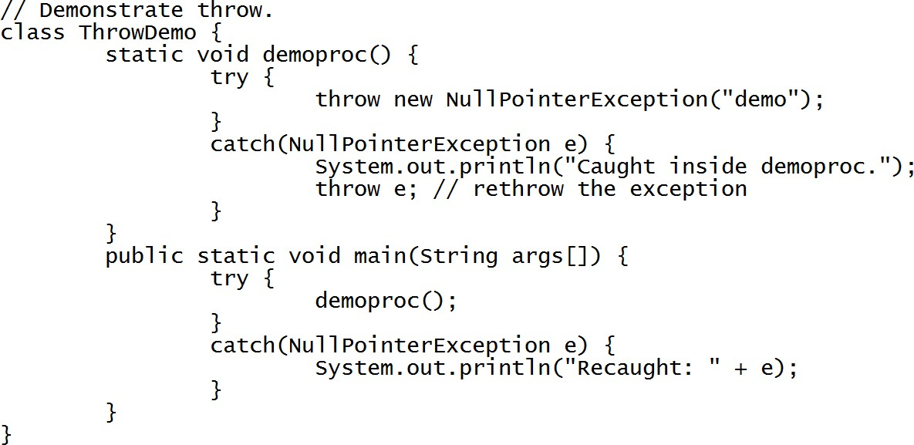
A sample program that creates and throws an exception. The handler that catches the exception rethrows it to the outer handler.

Slide 41
This program gets two chances to deal with the same error. First,
main( ) sets up an exception context and then calls demoproc( ).
The demoproc( ) method then sets up another exception handling context and immediately throws a new instance of NullPointerException, which is caught on the next line.
The exception is then rethrown. Here is the resulting output:
Caught inside demoproc.
Recaught: java.lang.NullPointerException: demo

Slide 42
The program also illustrates how to create one of Java’s standard exception objects.
throw new NullPointerException("demo");
Here, new is used to construct an instance of NullPointerException.
Many of Java’s built in run-time exceptions have at least two constructors: one with no parameter and one that takes a string parameter.
When the second form is used, the argument specifies a string that describes the exception.

Slide 43
Throws - is used to declare an exception.
Exceptions that a method can throw must be declared in the throws clause.
The general form of a throws clause is:
type method-name(parameter-list) throws exception-list
{
// body of method
}
Here, exception-list is a comma-separated list of the exceptions that a method can throw.

Slide 44

throws Example
public class TestThrows {
//defining a method
public static int divideNum(int m, int n) throws ArithmeticException {
int div = m / n;
return div;
}
//main method
public static void main(String[] args) { TestThrows obj = new TestThrows(); try {
System.out.println(obj.divideNum(45, 0));
}
catch (ArithmeticException e){ System.out.println("\nNumber cannot be divided by 0");
}
System.out.println("Rest of the code..");
}
}

Slide 45
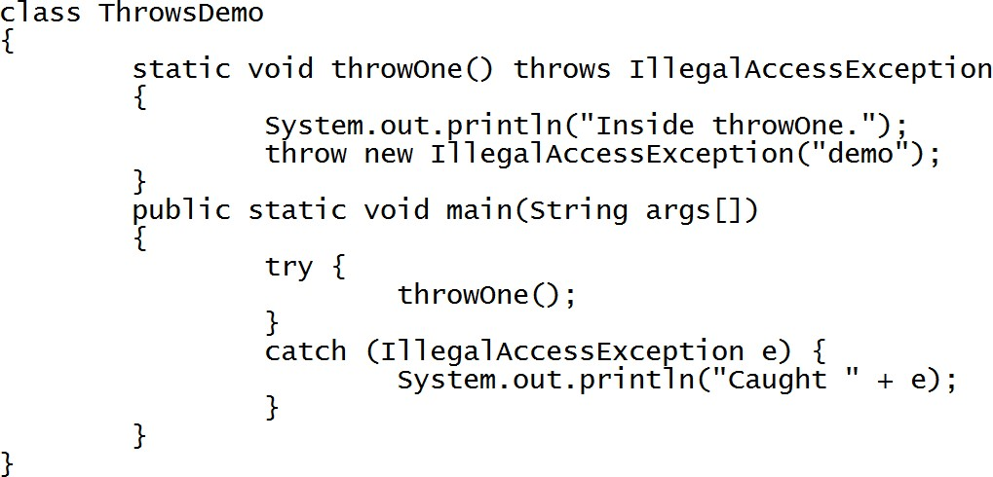
Throws
Output:
inside throwOne
caught java.lang.IllegalAccessException: demo

Slide 46
throw and throws Example
public class TestThrowAndThrows
{
// which throws ArithmeticException
static void method() throws ArithmeticException
{
System.out.println("Inside the method()");
throw new ArithmeticException("throwing ArithmeticException");
}
public static void main(String args[])
{
try {
method();
}
catch(ArithmeticException e) {
Output: Inside the method()
caught in main() method
System.out.println("caught in main() method");
}
}
}
// System.out.println("caught in main() method" + e);
Output:
Inside the method() caught in main() method
java.lang.ArithmeticException: throwing ArithmeticException

Slide 47
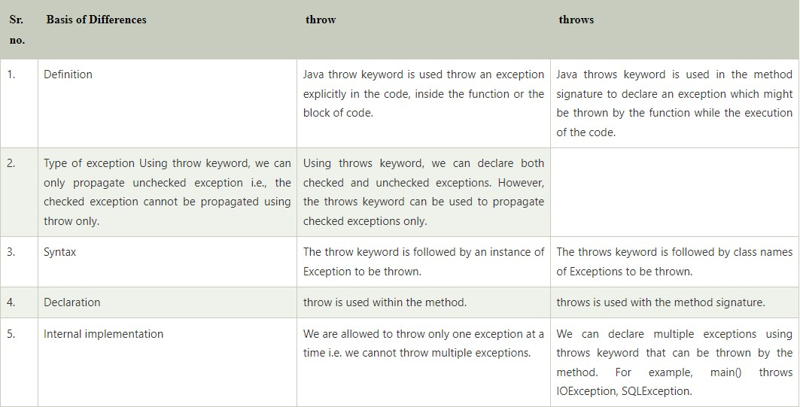
Difference between throw and throws

Slide 48
finally
Java finally block is a block used to execute important code such as closing the opened file, etc.
Java finally block is always executed whether an exception is handled or not. Therefore, it contains all the necessary statements that need to be printed regardless of the exception occurs or not.
The finally block follows the try-catch block.

Slide 49
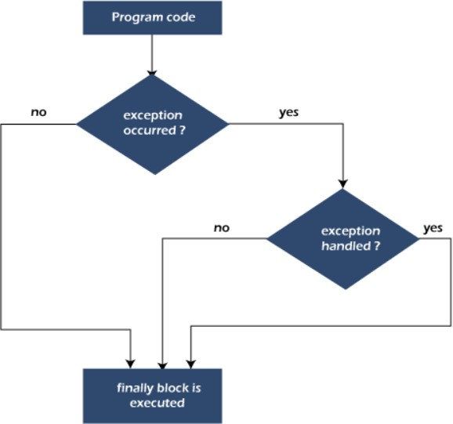
Flowchart of finally block
Note: If you don't handle the exception, before terminating the program, JVM executes
finally block (if any).

Slide 50
Why use Java finally block?
finally block in Java can be used to put "cleanup" code such as closing a file, closing connection, etc.
The important statements to be printed can be placed in the finally block.

Slide 51

Case 1: When an exception does not
occur
class TestFinallyBlock {
public static void main(String args[]){
try{
//below code do not throw any exception
int data=25/5; System.out.println(data);
}
//catch won't be executed
catch(NullPointerException e){ System.out.println(e);
}
//executed regardless of exception occurred or not
finally {
System.out.println("finally block is always executed");
}
System.out.println("rest of the code...");
}
}

Slide 52
Case 2: When an exception occur but not handled by the catch block -
Here, the code throws an exception however the catch block cannot handle it. Despite this, the finally block is executed after the try block and then the program terminates abnormally.
public class TestFinallyBlock1{
public static void main(String args[]){
try {
System.out.println("Inside the try block");
//below code throws divide by zero exception
int data=25/0;
System.out.println(data);
}
//cannot handle Arithmetic type exception , can only accept Null Pointer type exception
catch(NullPointerException e){ System.out.println(“Error”);
}
//executes regardless of exception occurred or not
finally {
System.out.println(“Finally block ");
}
Inside the try block
finally block
Exception in thread "main" java.lang.ArithmeticException: / by zero at TestFinallyBlock1.main(TestFinallyBlock1.java:9)
System.out.println("rest of the code...");
}
}

Slide 53
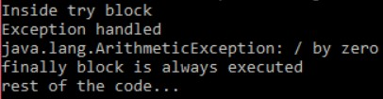
Case 3: When an exception occurs and is handled by the catch block. The Java code throws an exception and the catch block handles the exception. Later the finally block is executed after the try-catch block. Further, the rest of the code is also executed normally.
public class TestFinallyBlock2{
public static void main(String args[]){
try {
System.out.println("Inside try block");
//below code throws divide by zero exception
int data=25/0; System.out.println(data);
}
//handles the Arithmetic Exception / Divide by zero exception
catch(ArithmeticException e){
System.out.println("Exception handled"); System.out.println(e);
}
//executes regardless of exception occured or not
finally {
System.out.println("finally block is always executed");
}
System.out.println("rest of the code...");
}
}

Slide 54
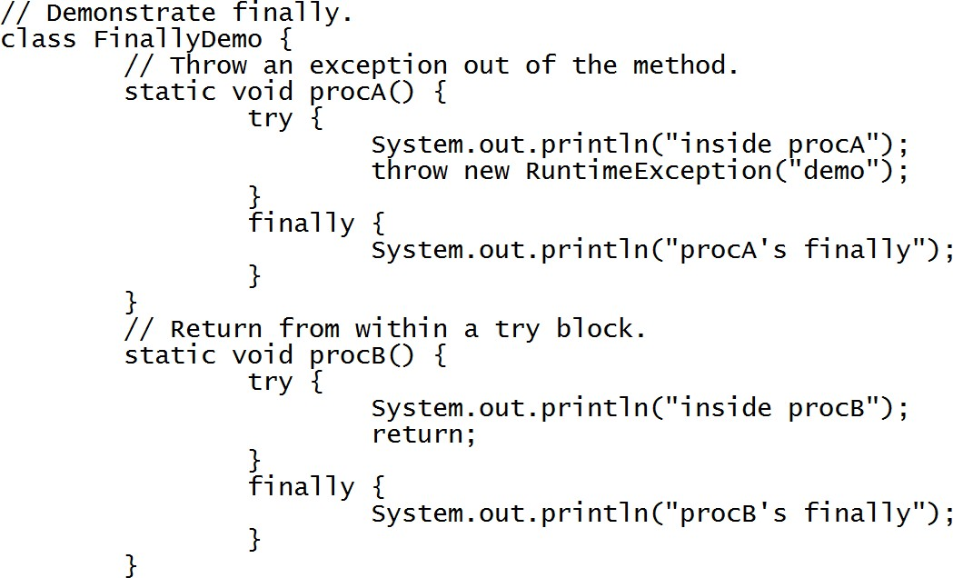
finally

Slide 55
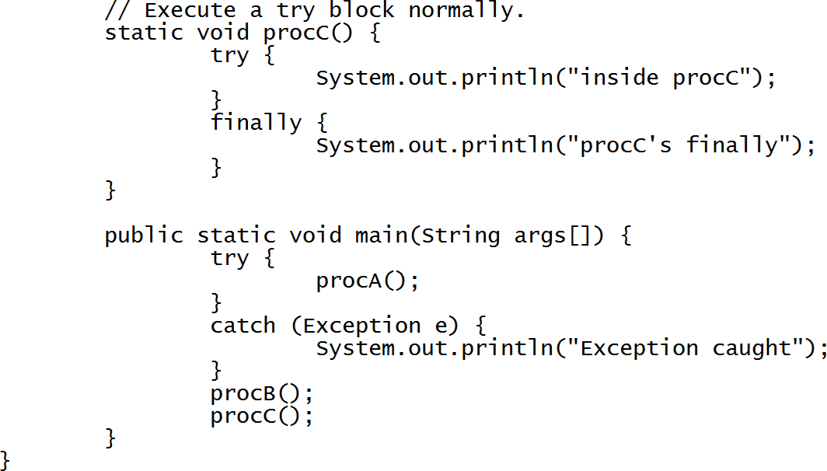
finally

Slide 56
OUTPUT:
inside procA
procA’s finally
Exception caught
inside procB
procB’s finally
inside procC
procC’s finally

Slide 57
In the above example, procA( ) prematurely breaks out of the try by
throwing an exception.
The finally clause is executed on the way out. procB( )’s try statement is exited via a return statement.
The finally clause is executed before procB( ) returns.
In procC( ), the try statement executes normally, without error.
However, the finally block is still executed.
REMEMBER If a finally block is associated with a try, the finally block will be executed upon conclusion of the try.
Here is the output generated by the preceding program:

Slide 58
Java’s Built-in Exceptions
Java defines several exception classes inside the standard package java.lang.
Unchecked exception or RuntimeException need not be included in the method’s throws list. Bcz Compiler does not check to see if a method handles or throws these exceptions.
Checked exception must be included in the method’s throws list.

Slide 59
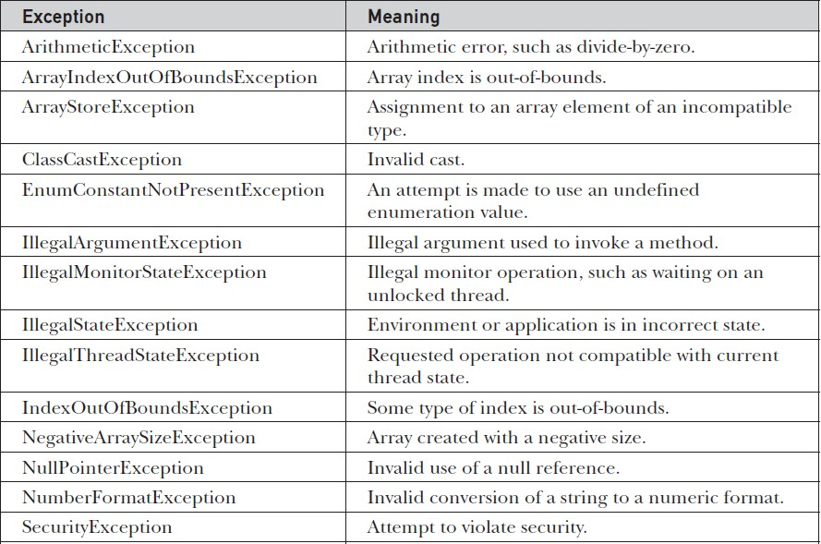
Unchecked Runtime Exception Subclasses defined in java.lang

Slide 60
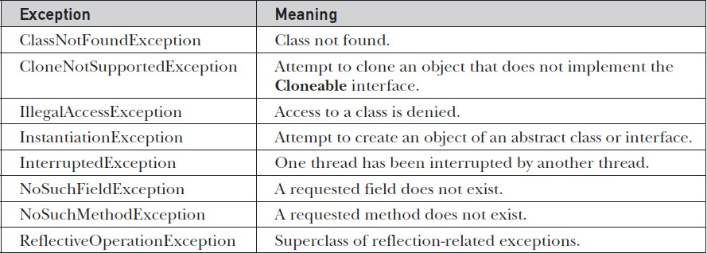
Java’s Checked Exceptions Defined in java.lang

Slide 61

THANK YOU

